Slide 1

Helping Humanitarian Aid Workers Identify Pediatric Pneumonia
presented for the American Red Cross

Slide 2


Hailstorm Analytics
Kyle Lindstrom
Nick Hall
Tech Lead
Presentation Lead

Slide 3
Overview
Identifying Pediatric Pneumonia
Business Problem
About the Data
Model
Conclusions
01
02
03
04
Humanitarian aid workers need tools to help identify those at risk.
Our team gathered sample data of pneumonia in children aged one to five.
We tested models that could accurately predict pneumonia cases.
We identified our best model and scored its performance.
03

Slide 4
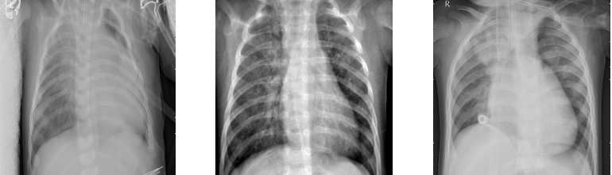
Every 43 seconds,
a child dies due to pneumonia.¹
Identifying Pediatric Pneumonia
04
Pneumonia is the most lethal infectious disease among children ages one to five worldwide.
¹According to UNICEF data

Slide 5

01
Targets developing nations
Countries in South Asia and sub-Saharan Africa are most at risk.
Identifying Pediatric Pneumonia
02
Too many cases
Aid workers currently lack the resources to treat all in need.
Business Problem
03
Need more tools
05
Humanitarian organizations like American Red Cross require better tools to identify those at risk.

Slide 6

About the Data
Identifying Pediatric Pneumonia
Published in 2018 | ~6,000 images
Collected by researchers at UCSD | Guangzhou Women and Children’s Medical Center
Children aged one to five | Verified results by three separate experts
06

Slide 7
Key Performance Metrics
Identifying Pediatric Pneumonia
Recall
Accuracy
Identify true positives
Make correct predictions
07

Slide 8
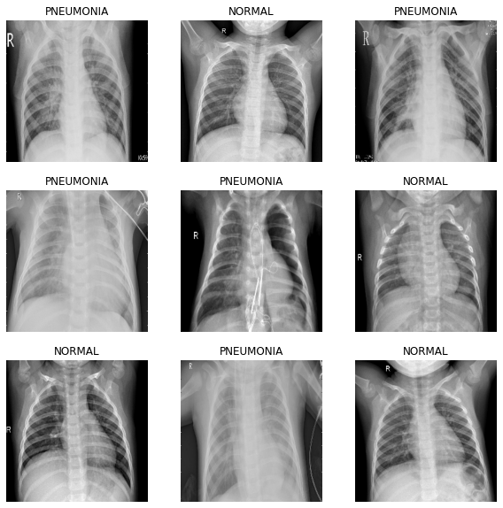
Identifying Pediatric Pneumonia
Example
Data
08

Slide 9
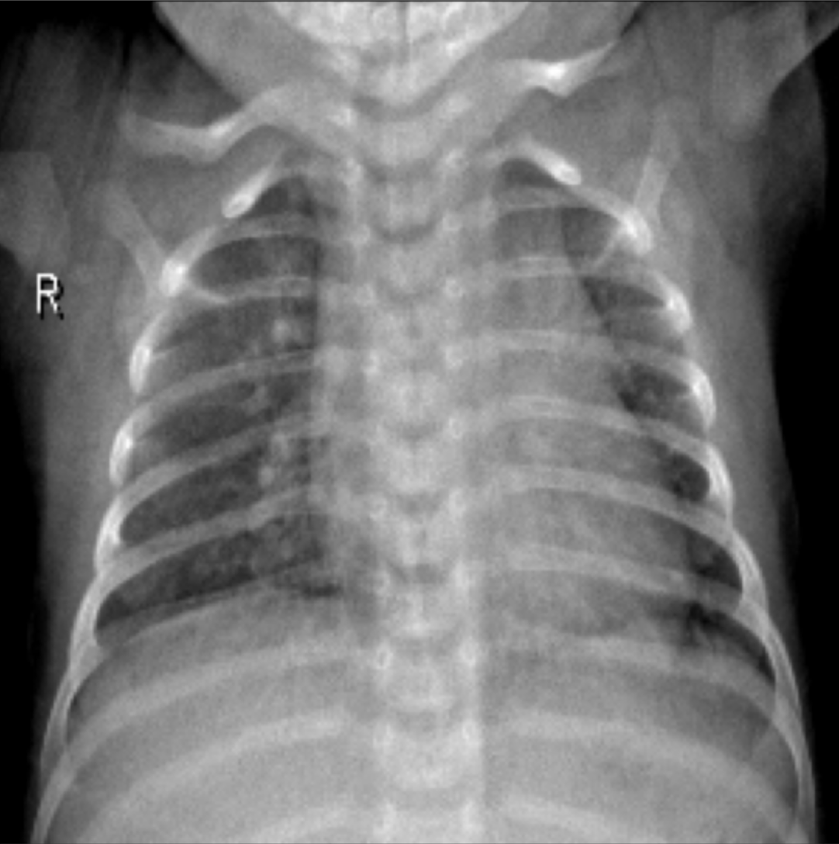
Augmentations
Horizontal Flip
Identifying Pediatric Pneumonia
Random Rotation
09

Slide 10

Model | Recall | Accuracy
Logistic Regression | 98% | 75%
Random Forest | 99% | 74%
Support Vector Machine | 98% | 76%
Convolutional Neural Network | 99% | 90%
Identifying Pediatric Pneumonia
Model Performance
10

Slide 11

Identifying Pediatric Pneumonia
Final Model
99% Recall
90% Accuracy
11

Slide 12
Future Insights
Identifying Pediatric Pneumonia
Acquire More Data
Expand Disease Detection
Improve model performance
Identify other common conditions
Multiclass Classification
Viral vs bacterial pneumonia
12

Slide 13
Thank You!
Kyle Lindstrom
Nick Hall
Tech Lead
Presentation Lead

